Slide 1
Word Search
TEAM AWESOME
By: Brandon Bosso, Austin Diviness, Naomi Plasterer and Jason Steinberg

Slide 2
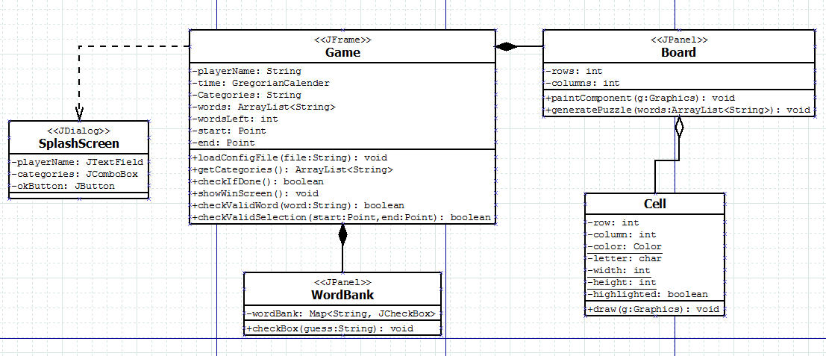
Design Process: UML

Slide 3
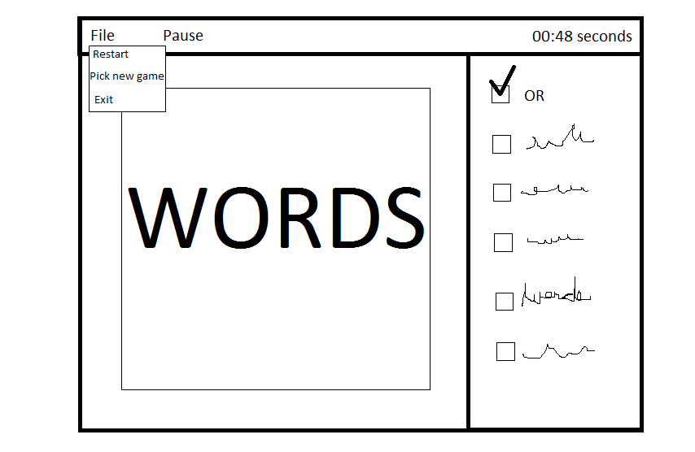
Design Process: Wireframe

Slide 4
Testing
Highlighting words
Loading words
Loading file names
Correct word
Correct selection
Word bank contains words
Game can be won

Slide 5
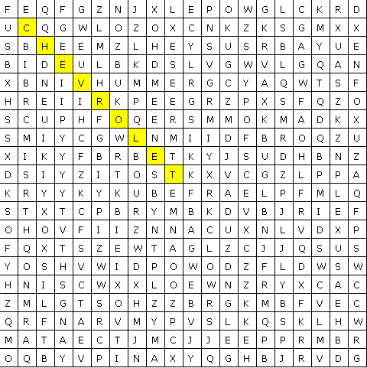

Functionality
HIGHLIGHTING
Auto Checking

Slide 6

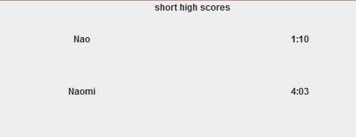
Functionality
TIMING AND HIGHSCORE BOARD

Slide 7
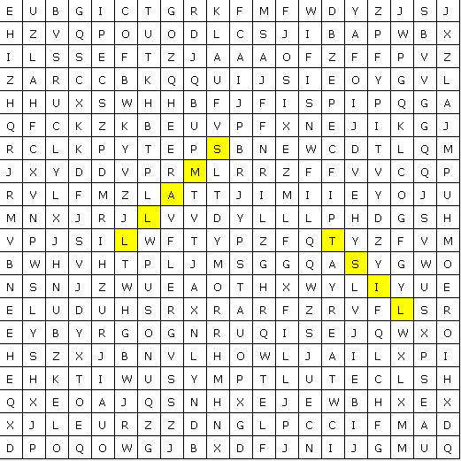
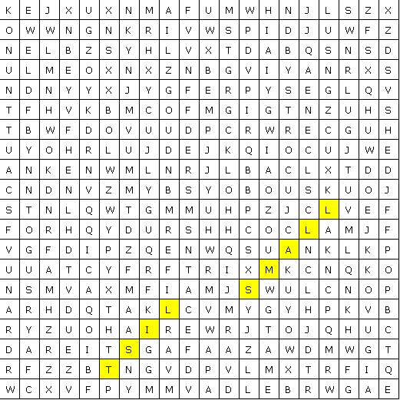
Functionality
WORDS PLACED RANDOMLY EVERY GAME

Slide 8
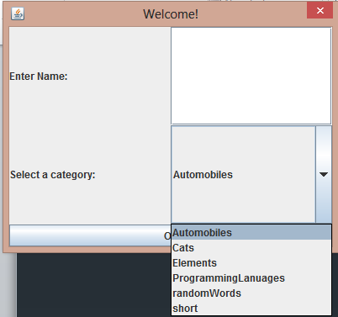
Functionality
CUSTIMIZABLE (ADD YOUR OWN LIST OF WORDS)

Slide 9
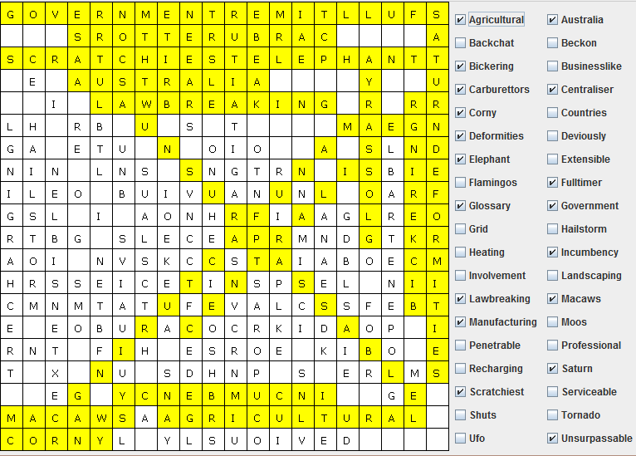
Functionality
DENSITY

Slide 10
Functionality
ALGORITHM FOR CROSSING
// / diagonal
case 2:
row = rand.nextInt(rows - word.length()) + word.length();
column = rand.nextInt(columns - word.length());
if(checkValidLocation(new Point(column, row), new Point(column + word.length(), row - word.length()), word)) {
for(int i = 0; i < word.length(); i++) {
getCellAt(row - i, column + i).setLetter(word.charAt(i));
}
}
else {
insertWord(word, ++timesTried);
}
break;

Slide 11
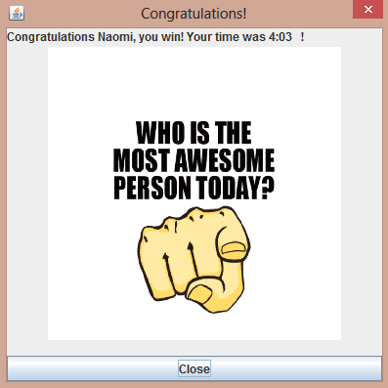
Functionality
EPIC GRAPHICS!

Slide 12
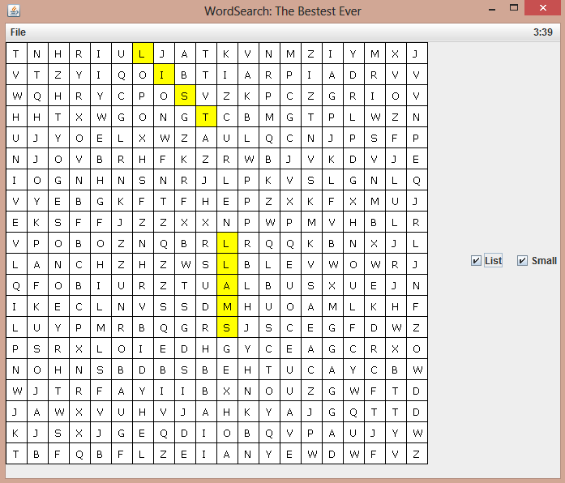
Complete Game
DEMO

Slide 13
Lessons Learned
Pair programming rocks [in a sufficiently sized room]
Git is helpful [when it doesn’t get corrupted]
Row and column should not be confused with column and row
Testing really helps in a group.

